Slide 1
ICAO SARPS and Guidance Material
PBCS Workshop
Bangkok, Thailand, 13-14 May, 2013

Slide 2
1 - Current ICAO provisions

Slide 3
RCP - Annex 6 – Operation of Aircraft
“7.1.3 For flights in defined portions of airspace or on routes where an RCP type has been prescribed, an aeroplane shall in addition to the requirements specified in 7.1.1
be provided with communications equipment which will enable it to operate in accordance with the prescribed RCP type(s); and
be authorized by the state of the operator for operations in each airspace”
Note: provides reference to Doc 9869 RCP Manual

Slide 4
RCP- Annex 11 – Air Traffic Services
2.8 Required communication performance (RCP)
2.8.1 RCP types shall be prescribed by states. When applicable, the RCP type(s) shall be prescribed on the basis of regional air navigation agreements.
2.8.2 The prescribed RCP type shall be appropriate to the air traffic services provided in the airspace concerned.
Note: provides reference to Doc 9869 RCP Manual

Slide 5
RCP - Annex 11 – Air Traffic Services
6.1 Aeronautical Mobile Service (air-ground)
6.1.1.2 Where RCP types have been prescribed by states for ATM functions, ATS units shall, in addition to the requirements specified in 6.1.1.1 be provided with communication equipment which will enable them to provide ATS in accordance with the prescribed RCP types.
6.2 Aeronautical Fixed Service (ground-ground)
6.2.1.2 Where RCP types have been prescribed by states for ATM functions, ATS units shall…… (as per 6.1.1.2)

Slide 6
RCP - Annex 11 – Air Traffic Services
2.27 Safety Management
2.27.5 Any significant safety related change to the ATS system, including the implementation of a reduced separation minima or a new procedure, shall only be effected after a safety assessment has demonstrated that an acceptable level of safety has been met. When appropriate, the responsible authority shall ensure that adequate provision is made for post implementation monitoring to verify that the defined level of safety continues to be met.
3.3 Operation of air traffic control service
3.3.5.2 Arrangements shall be put in place, through inter-regional agreement, for the sharing between regions of data from monitoring programs.

Slide 7
RCP - Doc 4444 – PANS-ATM
4.4.1.4 An operator shall, prior to departure:
(c) ensure that, where the flight is intended to operate where an RCP type is prescribed, the aircraft has an appropriate RCP approval, and that all conditions applying to that approval will be satisfied.

Slide 8
RCP - Doc 4444 – PANS-ATM
5.4.1.2.1.6 Lateral separation of aircraft on parallel or non-intersecting tracks or ATS routes…………
b) for a minimum spacing between tracks of 55.5 km (30 NM) a navigational performance of RNP 4 shall be prescribed.
Note 2.— Guidance material for implementation of communication capability supporting 93 km (50 NM) and 55.5 km (30 NM) lateral separation is contained in the Manual on Required Communication Performance (RCP) (Doc 9869). Information regarding RCP allocations for these capabilities is contained in RTCA DO-306/EUROCAE ED-122 Safety and Performance Standard for Air Traffic Data Link Services in Oceanic and Remote Airspace (Oceanic SPR Standard).

Slide 9
RCP/RSP - Doc 4444 – PANS-ATM
5.4.2.6.4 Longitudinal distance-based separation minima in an RNP RNAV environment using ADS-C
5.4.2.6.4.3.2 The communication system provided to enable the application of the separation minima in 5.4.2.6.4.3 shall allow a controller, within 4 minutes, to intervene and resolve a potential conflict by contacting an aircraft using the normal means of communication. An alternative means shall be available to allow the controller to intervene and resolve the conflict within a total time of 10½ minutes, should the normal means of communication fail.
5.4.2.6.4.3.3 When an ADS-C periodic or waypoint change event report is not received within 3 minutes of the time it should have been sent, the report is considered overdue and the controller shall take action to obtain the report as quickly as possible, normally by ADS-C or CPDLC. If a report is not received within 6 minutes of the time the original report should have been sent, and there is a possibility of loss of separation with other aircraft, the controller shall take action to resolve any potential conflict(s) as soon as possible. The communication means provided shall be such that the conflict is resolved within a further 7½ minutes.
RCP240
RSP180

Slide 10
2 – PBCS implementation supported by updates to ICAO publications

Slide 11
PBCS – ICAO amendments
Air traffic services are becoming more dependent on communication and surveillance services as seen by a number of initiatives planned throughout the world.
Plans are underway in the regions to address the performance of those services through implementation of performance-based communication and surveillance (PBCS), and the prescription of required communication performance (RCP) and required surveillance performance (RSP) specifications.

Slide 12
PBCS – ICAO amendments
As ICAO regions implement PBCS, a coordinated effort will be essential to ensure consistent application on a worldwide basis.
The Operational Data Link Panel (OPLINKP) and the Separation and Airspace Safety Panel (SASP) work programs include tasks to provide this coordination through amendments to ICAO Annexes and Documents.

Slide 13
2 – SASP proposals for amendment PANS-ATM Doc 4444

Slide 14
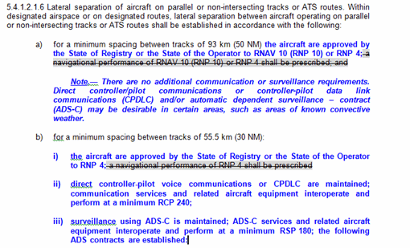
PBCS– ICAO SASP amend Doc 4444?

Slide 15
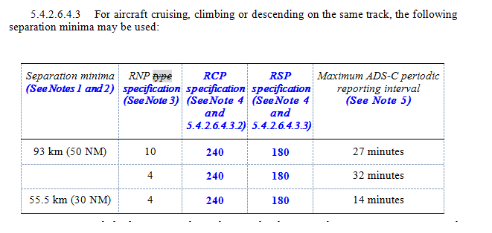
PBCS– ICAO SASP amend Doc 4444?

Slide 16
2 – OPLINKP proposals for amendment PANS-ATM Doc 4444

Slide 17
PBCS – Proposed PANS-ATM Doc 4444 Amendments
OPLINKP has proposed amendments to the provisions for the flight plan to support global application of PBCS and the prescription of RCP and RSP specifications.
The OPLINKP amendments also support SASP work to develop standards for separation minima that are predicated on communication and surveillance performance.
OPLINKP proposes the amendments be published as soon as possible, preferably no later than 2014, to support the North Atlantic PBCS Implementation Plan and PBCS initiatives planned in other ICAO Regions.

Slide 18
PBCS – Proposed PANS-ATM Doc 4444 Amendments
The proposed Doc 4444 amendment includes:
The flight plan provisions concerning PBCS, as agreed at OPLINKP/WG/WHL/3;
A definition of the P3 descriptor in Item 10 for the RCP 150 specification;
Addition of notes that refer to Doc 9869 (manual of RCP);
Revised definitions for the NAV/, COM/, DAT/ and SUR/ indicators and related notes for consistency.

Slide 19
PBCS – Proposed PANS-ATM Doc 4444 Amendments
Item 10a – communications equipment
Note 7.— Guidance material on the application of performance-based communication, which prescribes RCP to an air traffic service in a specific area, is contained in the Performance- Based Communication and Surveillance (PBCS) Manual (Doc 9869).
Item 10b – surveillance equipment
Note 1.- If the descriptor D1 is used, the performance-based surveillance level that can be met are specified in Item 18 following the indicator SUR/. Guidance material on the application of performance-based surveillance, which prescribes RSP to an air traffic service in a specific area, is contained in the Performance-Based Communication and Surveillance (PBCS) Manual (Doc 9869).
Note 2.— Additional surveillance equipment or capabilities should be listed in Item 18 following the indicator SUR/, as required by the appropriate ATS authority.
P1 | RCP 400 (See Note 7)
P2 | RCP 240 (See Note 7)
P3 | RCP 150 (See Note 7)
P4–P9 | Reserved for RCP (See Note 7)

Slide 20
PBCS – Proposed PANS-ATM Doc 4444 Amendments
Item 18 – other equipment
COM/ Significant data related to communication equipment or capabilities, other than specified in Item 10 a), as required by the appropriate ATS authority.
DAT/ Significant data related to data communications equipment or capabilities, other than specified in 10 a), as required by the appropriate ATS authority.
SUR/ Significant data related to surveillance equipment or capabilities, other than specified in Item 10 b), as required by the appropriate ATS authority. Indicate RSP400 or RSP180 under this indicator, when D1 is filed in Item 10b.

Slide 21
2 – OPLINKP proposals for amendment Annex 6, Annex 11

Slide 22
PBC - proposed amendments Annex 6, Annex 11
The Operation of Aircraft (Annex 6) and Air Traffic Services (Annex 11), are appropriate for providing the standards concerning the implementation of PBCS.
The Performance-Based Communication and Surveillance (PBCS) Manual (Doc 9869) will provide guidance material appropriate for the standards.
Note: Doc 9869 Manual of RCP to be renamed PBCS Manual
OPLINKP proposes the amendments be published as soon as possible, preferably no later than 2014, to support the North Atlantic PBCS Implementation Plan and PBCS initiatives planned in other ICAO Regions.

Slide 23
PBC - proposed amendments Annex 6, Annex 11
The amendments include:
the standards associated with PBCS, similar to the standards for performance-based navigation (PBN), and refer to guidance material contained in Doc 9869.
Note 1: only a proposed amendment to Annex 6 Part 1 – International Commercial Air Transport - Aeroplanes has been developed at this stage
Note 2: amendments assume modifications to Doc 9869 per OPLINKP proposals (refer section 3 below)
Annex 6 and Annex 11, acronyms, publications and Definitions, were amended to add terms, revise existing terms and publication titles related to PBC and PBS.

Slide 24
PBC - proposed amendments Annex 6, Annex 11
The amendments include:
Annex 6, Chapter 7, Aeroplane Communications and Navigation Equipment, was amended to revise existing provisions from RCP to PBC, similar to PBN and to add provisions for surveillance equipment and PBS.
Annex 6, Chapter 7, amended to include a provision that the State, prior to granting authorization to operators for RCP and RSP operations, should ensure adequate programs are in place to monitor for continued operational safety. These programs would include monitoring against RCP/RSP specifications and corrective actions.

Slide 25
PBC - proposed amendments Annex 6, Annex 11
The amendments include:
Annex 6, Appendix 6, Air Operator Certificate (AOC), was amended to include provisions for PBCS in the operations specifications layout.
Annex 11, Chapter 2, General, was amended to revise existing provisions from RCP to PBC, similar to PBN and to add provisions for surveillance equipment and PBS.

Slide 26
PBC - proposed amendments Annex 6, Annex 11
The amendments include:
Annex 11, Chapter 3, Air Traffic Control Service, was amended to include a provision to establish a program, on a regional basis, for monitoring the performance of the communication and surveillance infrastructure and participating aircraft against the appropriate RCP and RSP specifications.
Annex 11, Chapter 3, as also amended to include provisions for surveillance equipment and prescription of RSP specifications for performance-based surveillance.

Slide 27
PBC - proposed amendments Annex 6, Annex 11
The amendments include:
Annex 11, Chapter 6, Air Traffic Services Requirements for Communications, was amended to revise the provisions for communication equipment and prescription of RCP specifications for performance-based communication.

Slide 28
PBC - proposed amendments Annex 6, Annex 11
Performance-based communication (PBC).
ATS communication services and capability based on performance requirements for air traffic service provision, aircraft and flight operations along an ATS route, on an instrument approach procedure or in a designated airspace.
Note.— Communication performance requirements are allocated to system components in an RCP specification in terms of communication transaction time, continuity, availability, integrity, safety and functionality needed for the proposed operation in the context of a particular airspace

Slide 29
PBS - proposed amendments Annex 6, Annex 11
Performance-based surveillance (PBS).
ATS surveillance services and capability based on performance requirements for air traffic service provision, aircraft and flight operations along an ATS route, on an instrument approach procedure or in a designated airspace.
Note.— Surveillance performance requirements are allocated to system components in an RSP specification in terms of surveillance data delivery time, continuity, availability, integrity, accuracy of the surveillance data, safety and functionality needed for the proposed operation in the context of a particular airspace concept.

Slide 30
PBC - proposed amendments Annex 6, Annex 11
Required communication performance (RCP) specification.
A set of requirements for air traffic service provision, aircraft capability, and operations needed to support performance-based communication within a defined airspace.
Note: The term RCP, has been revised to align the concept of PBC with the concept of PBN. The term RCP is now used in the context of a specification that is applicable to the prescription of airspace requirements, qualification of ATS provision, aircraft capability, and operational use, including post-implementation monitoring (e.g. RCP 240 refers to the criteria for various components of the operational system to ensure an acceptable intervention capability for the controller is maintained).

Slide 31
PBC - proposed amendments Annex 6, Annex 11
Required surveillance performance (RSP) specification.
A set of requirements for air traffic service provision, aircraft capability, and operations needed to support performance-based surveillance within a defined airspace.
Note: The term RSP is used in the context of a specification that is applicable to the prescription of airspace requirements, qualification of ATS provision, aircraft capability, and operational use, including post-implementation monitoring (e.g. RSP 180 refers to the criteria for various components of the operational system to ensure an acceptable surveillance capability for the controller is maintained.

Slide 32
PBCS - proposed amendments Annex 6 Chapter 7
7.1.4 Prior to granting authorization for RCP operations in accordance with 7.1.3 b), the State shall be satisfied that:
a) the performance of the communication capability of the aeroplane satisfies the appropriate interoperability requirements and RCP specifications;
b) the operator has instituted appropriate procedures in respect of continued airworthiness (maintenance and repair) practices and programmes; and
c) the operator has instituted appropriate flight crew procedures for RCP operations.
Note.— An authorization for RCP operations is valid globally on the understanding that any operating procedures specific to a given region will be stated in the operations manual or appropriate crew guidance.

Slide 33
PBCS - proposed amendments Annex 6 Chapter 7
7.1.5 Where an aeroplane has been authorized for RCP operations in accordance with 7.1.3 b), the State of the Operator, in consultation with the State of Registry if appropriate, shall ensure that adequate provisions exist to evaluate continued operational safety, including:
a) ensuring that communication performance is monitored by the monitoring agencies established in accordance with Annex 11, 3.3.5.2;
b) receiving the reports of observed communication performance issued by such monitoring agencies in accordance with Annex 11, 3.3.5.3; and
b) taking immediate corrective action for individual aircraft, aircraft types or operators, identified in such reports as not complying with the RCP specification in the applicable airspace.

Slide 34
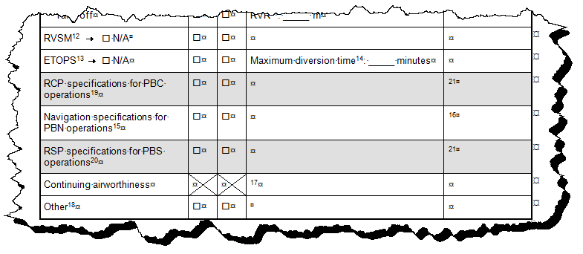
PBCS - proposed amendments Annex 6 Appendix 6
Changes to Air Operator Certificate:

Slide 35
PBCS - proposed amendments Annex 6 Appendix 6
Changes to Air Operator Certificate – new notes:
19. Performance-based communication (PBC): one line is used for each RCP specification authorization (e.g. RCP 240, RCP 150), with appropriate limitations or conditions listed in the “Specific Approvals” and/or “Remarks” columns.
20. Performance-based surveillance (PBS): one line is used for each RSP specification authorization (e.g. RSP 180), with appropriate limitations or conditions listed in the “Specific Approvals” and/or “Remarks” columns.
21. Limitations, conditions and regulatory basis for operational approval associated with the RCP or RSP specification (e.g. SATCOM, VDL Mode 2, media routing policies, service agreements). Information on performance-based communication and surveillance, and guidance concerning the implementation and operational approval process, are contained in the Performance-based Communication and Surveillance (PBCS) Manual (Doc 9869).

Slide 36
PBCS - proposed amendments Annex 11 Chapter 2
2.8.1 In applying performance-based communication, RCP specifications shall be prescribed by States. When applicable, the RCP specification(s) shall be prescribed on the basis of regional air navigation agreements. In designating a RCP specification, limitations may apply as a result of communication infrastructure constraints or specific communication functionality requirements.
Recommendation.— When implementing an air traffic service, such as a separation minimum, that is predicated on communication performance, performance-based communications should be applied to ensure the communication system meets applicable performance requirements initially and in continued operations.
2.8.2

Slide 37
PBCS - proposed amendments Annex 11 Chapter 2
2.8.2 The prescribed RCP specification shall be appropriate to the air traffic services provided in the airspace concerned taking into account navigation and surveillance capability.
Note.— Applicable guidance on performance-based communication and implementation is published in the Performance-Based Communication and Surveillance Manual (Doc 9869)
Similar amendment proposals for RSP in 2.9

Slide 38
PBCS - proposed amendments Annex 11 Chapter 3
3.3.5.2 For all airspace where the separation minimum being applied is predicated on communication and/or surveillance performance, a programme shall be instituted, on a regional basis, for monitoring the performance of the infrastructure and the participating aircraft against the appropriate RCP and/or RSP specifications, to ensure that operations continue to meet safety objectives. The scope of regional monitoring programmes shall be adequate to conduct analyses on an operator basis taking into account individual aircraft, aircraft types and various infrastructure and technological dependencies (e.g. sub-network types, sub-network routing policies, frequencies), all of which are factors in evaluating the stability of communication or surveillance performance.

Slide 39
2 – OPLINKP proposals for amendment Doc 9869 Manual of RCP

Slide 40
PBCS - proposed amendments Doc 9869
Currently, the RCP and RSP specifications and post-implementation monitoring guidance material for PBCS are provided in the GOLD.
ICAO Secretariat has informed Panels that the GOLD can not be referenced in Doc 4444.
OPLINKP agreed to update the Manual on Required Communication Performance (RCP) (ICAO Doc 9869) :
by renaming to Performance-Based Communication and Surveillance (PBCS) Manual
to include Appendices B, C and D of the GOLD Edition 2.

Slide 41
PBCS - proposed amendments Doc 9869
The GOLD, First Edition, Appendix C, refers to “surveillance performance specifications.” The GOLD, Second Edition, refers specifically to “RSP specifications.”
For these reasons and others, the Second Edition of the GOLD will provide the basis for the update to Doc 9869.
The updated Doc 9869 together with the Annex 6 and 11 amendments for PBCS will allow the SASP to refer to RCP and RSP specifications in standards for existing and planned separation minima and procedures provided in Doc 4444.

Slide 42
Thank you Paul Radford Manager Oceanic Systems Airways New Zealand paul.radford@airways.co.nz

